Slide 1
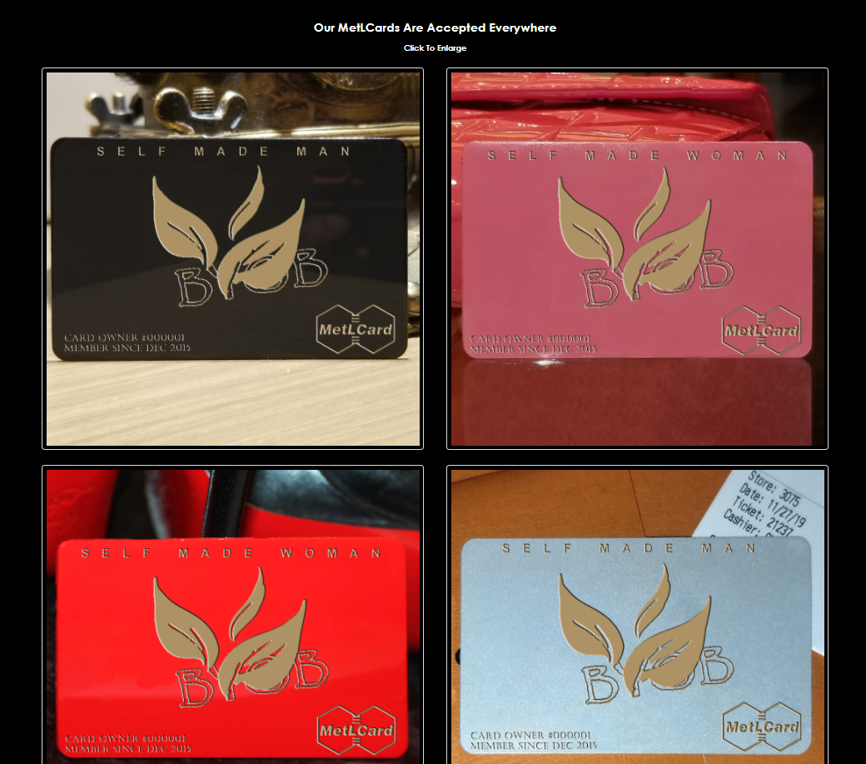
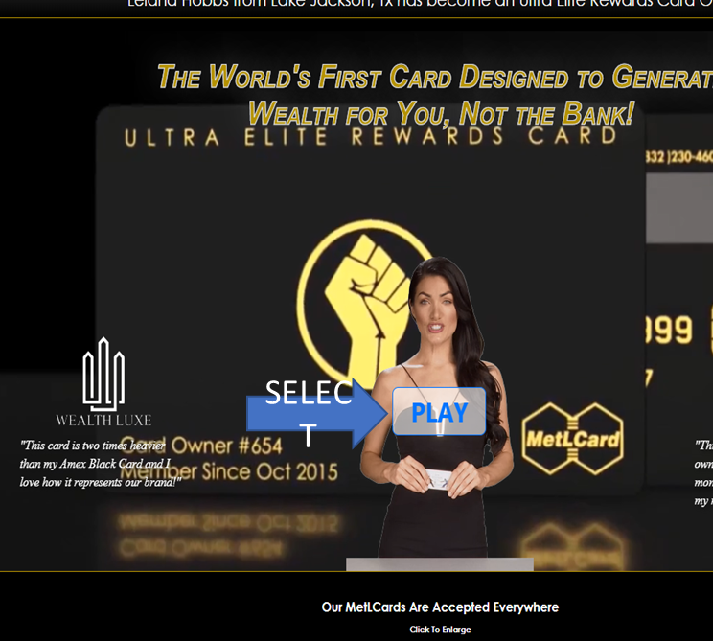
Here is a display of our amazing
BYOB CARD
Ordering Manual

Slide 2
How It Works
* Card Helps You With Marketing
* No Credit Check For The Card
* Card Comes With a Virtual Card
* Can Be Loaded With Your Debit Card
* Zelle, PayPal, Cash App Loadable
* Card Can Be Loaded With Bitcoin
* Unlimited Daily Card Transfers
* Unlimited Weekly Card Transfers
* Unlimited Monthly Card Transfers
* Unlimited Card To Card Transfers
* Unlimited Max Card Balance
* $5,000 ATM Withdrawal Per Day
* Major Discounts On Car Rentals
* Major Discounts On Theme Parks
Benefits of
Our Amazing Wallet
* No Limit Per Day On Card Purchases
* No Limit On Card To Card Transfers
* No Limit On Direct Debit Bill Pay
* Available To None US Citizens
* Card Comes With a Bank Account
* Free Point of Sale Transactions
* Free International Card Transfers
* Card Has Zero Liability Protection
* Card is FDIC Insured for $250,000
* Card Can Accept Direct Deposit
* Our Cards Are Accepted Everywhere
* Card Is Made of Heavy Metal
* Major Discounts On Hotels
Step 1. Click the MAKE MY CARD button and provide us with your information.
Step 2. After you pay for your Card use the provided link to set up your account with the bank.
Step 3. We will send you a postage paid envelop for you to send us the plastic card the bank sends to you
Step 4. When your plastic card arrives to us we will turn it into a beautiful Metal Card and ship it to you along with the plastic card within 4 - 5 days of us receiving it from you.
Helps You Save Money • Helps You Earn Money • Helps You Multiply Money

Slide 3
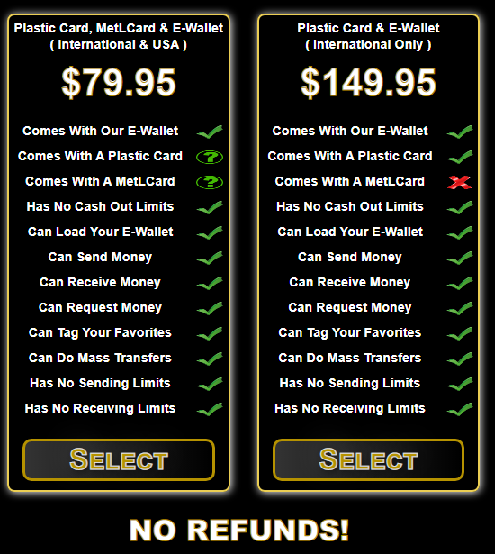
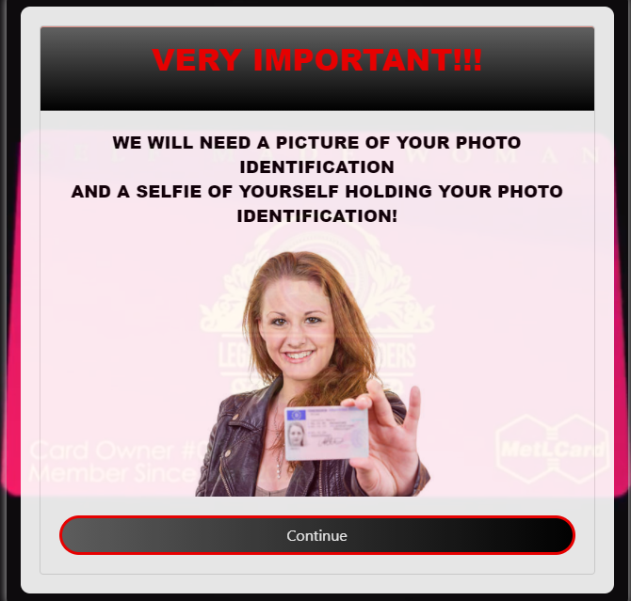
click Continue
Select A Card

Slide 4
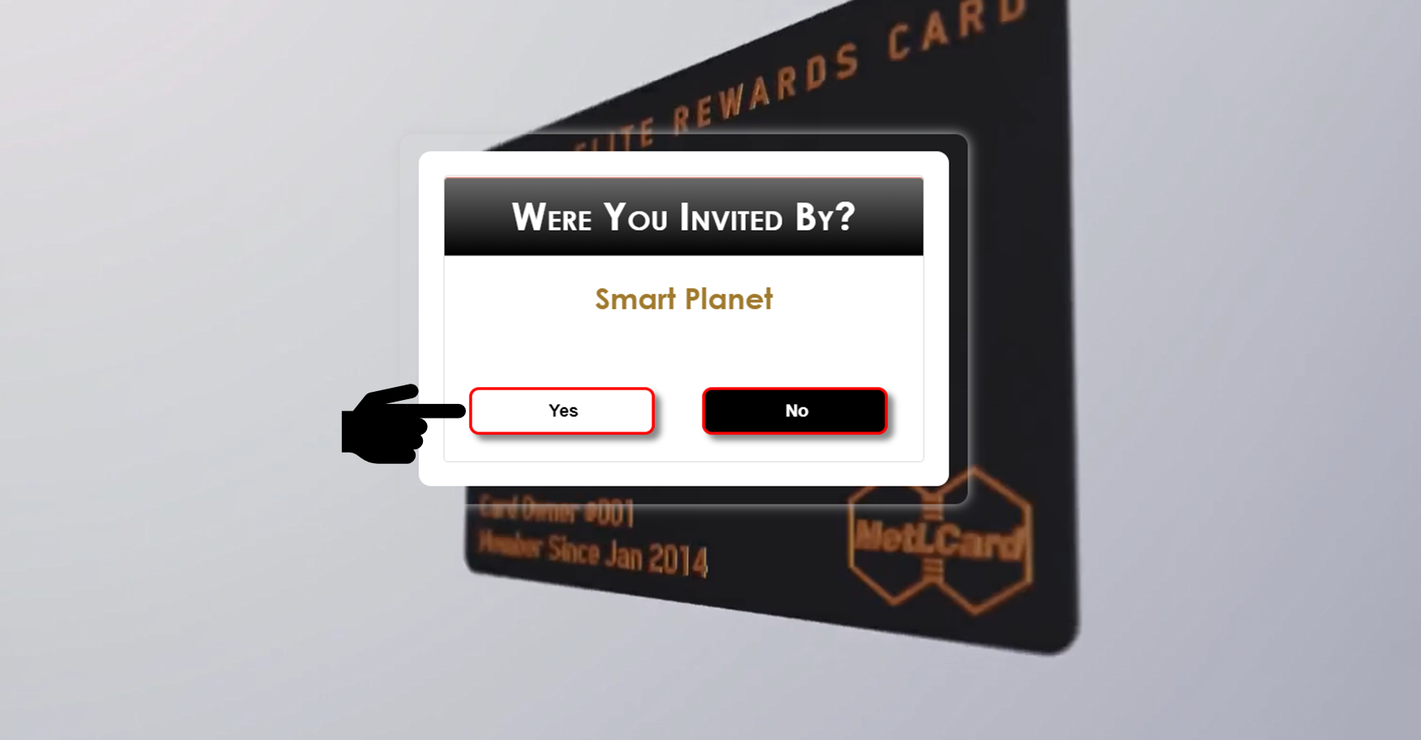
Make your card and move forward to Who You Was Invited By
Smart Planet
Type sponsor promo code

Slide 5
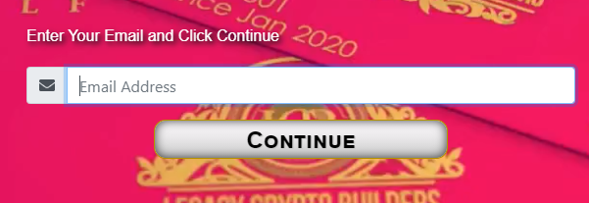
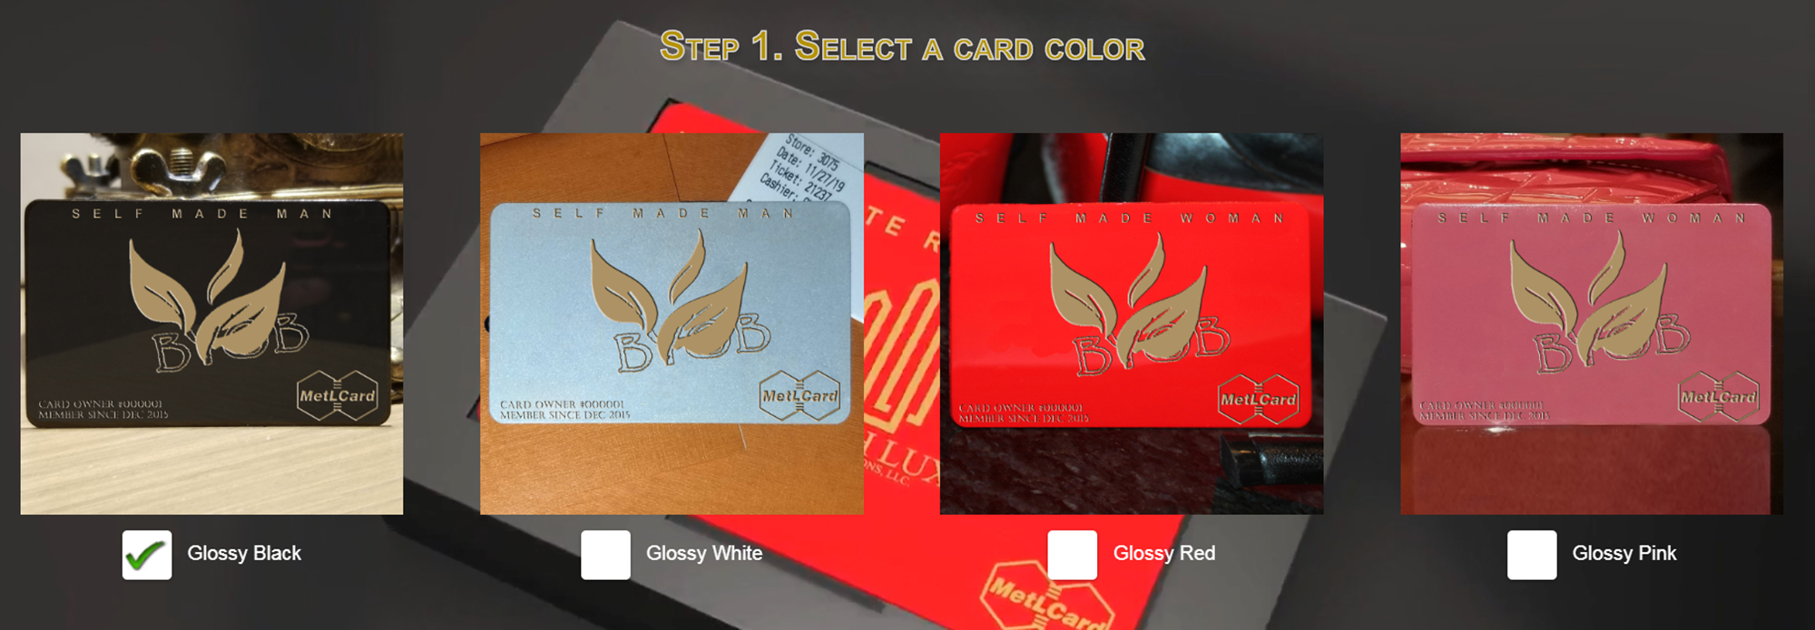
Enter your email and click Continue
Choose your card

Slide 6
Create your own card title

Slide 7
Enter the information you want in Lower Left & click Continue

Slide 8
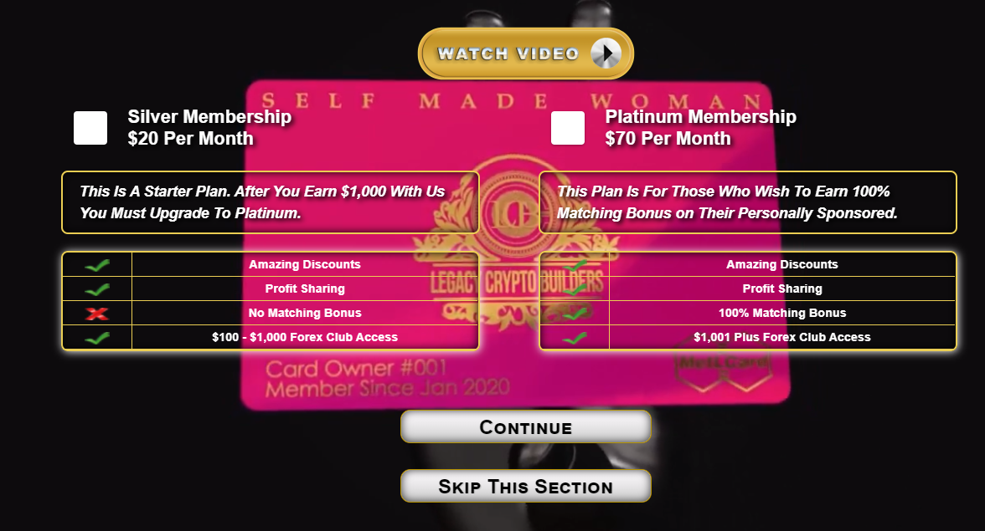
Step 3. Select what you want for the bottom left of the card
Step 4. Want to use your card to earn a monthly residual?
Residual Income is optional
Step 5. Select which membership to earn a monthly residual?

Slide 11
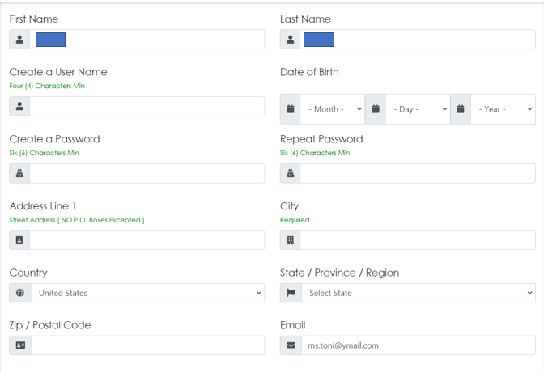
Fill Out Form If You Do Not Have A Blue Bird Card
Agree to the Terms click Continue

Slide 12
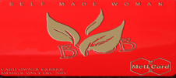
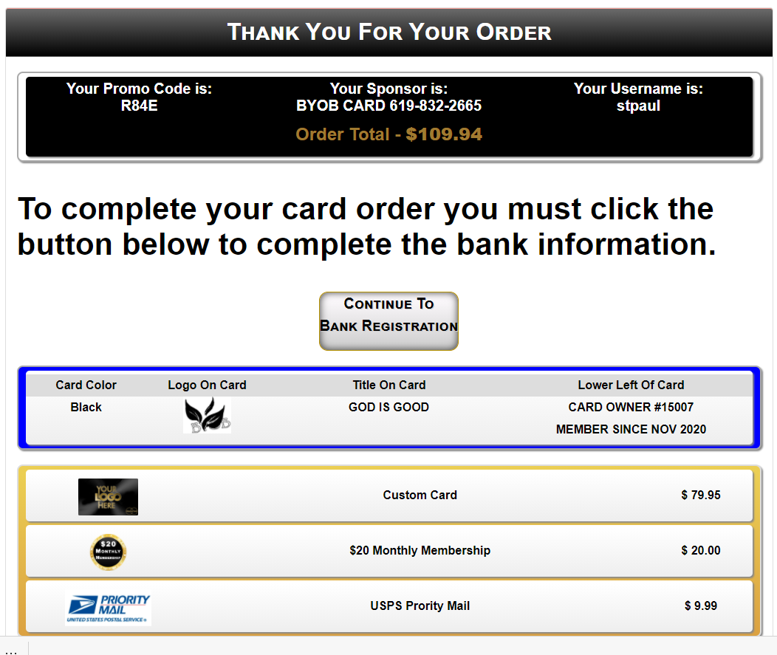
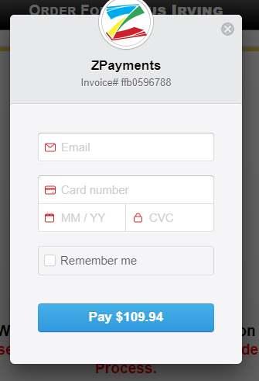
click Pay Now
Enter Info for Email & Payment
click Pay
Thank You for
Your Payment

