Slide 2
Download rockitcoInx App
This is the screen you’ll see when you open app.
Click on Create account.

Slide 3
Download rockitcoInx App
Click on Get Started.

Slide 4
Download rockitcoInx App
Create a username that you will remember.
Click Next

Slide 5
Download rockitcoInx App
Create a password that you will remember.
Click Next

Slide 6
Download rockitcoInx App
Create a 4-digit PIN that you will remember.
Click Next

Slide 7
Download rockitcoInx App
Click on show account information. If it looks good
Click Next

Slide 8
Download rockitcoInx App
Click to place a check mark in each circle.

Slide 9
Download rockitcoInx App
Click on Add Wallet

Slide 10
Download rockitcoInx App
Click on Bitcoin (Segwit) – BTC
Choose currency
Click Next
Click Create Wallet

Slide 11
Download rockitcoInx App
Click on BTC My Bitcoin

Slide 12
Download rockitcoInx App
Click on Request
Click on the BTC address at the bottom.
Click OK
Copy the Address
Go to Website http://rockitcoin.com

Slide 13
Download rockitcoInx App
Click
Wait for the screen to completely load and click on
Buy Online – It’s in the Orange Link above the picture.

Slide 14
Download rockitcoInx App
Change the 120 to a minimum of 50 and click Continue. It will not take less than $50.
Paste in your BitCoin Wallet Address
Click Continue.
Use a personal debit or credit card to make your purchase. Debit cards work best.

Slide 15
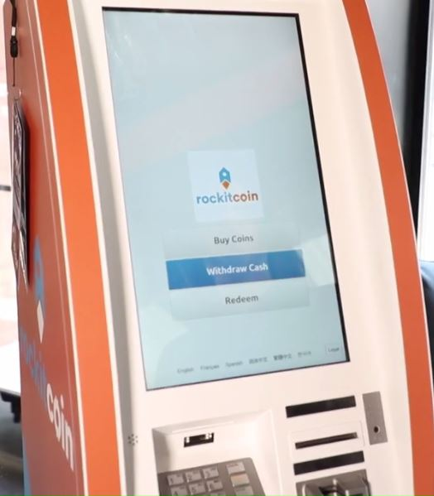
If you don’t have a bank account, you can use cash at a rockitcoIn atm to load your wallet
You can use the app to find the nearest on to you. You should have o do this only one time. Because all of the future money coming to your wallet will be in the form of transfers from others.

Slide 16
Go to rockitcoIn atm
This is the screen you’ll see when you will first walk up to the ATM.

Slide 17
Select “buy coin” option
From this menu you’ll select “buy coin” option.

Slide 18
Transaction page
You’ll see a transaction page. Select from the price ranges depending on your requirement.

Slide 19
Identity verification
On this page, you’ll need to verify your identity by providing your phone number on any other information that system asks.

Slide 20
Confirmation warning
After identity verification you will get an important warning for the confirmation to ensure account’s security. Check all the boxes to continue.

Slide 21
Secret pin
As you can see in the picture, you need to enter your secret pin.

Slide 22
Scan qr code
On scanning the QR code on your wallet, the scanner above the ATM keypad will light up red.

Slide 23
Wallet window
Under the wallet window, confirm the amount and address of the account on which you want to send bitcoins. Be careful, if sent to wrong address then it cant be reverted.

Slide 24
Input bills
After completing the entries on wallet window. The bill acceptor slot will start to blink green. Enter bills in the acceptor slowly. Put the bills one after another until you balance reaches to the desired amount.

Slide 25
Finish
Once you have reached the desired amount, you can tap on finish option.

Slide 26
Get receipt
On the last screen choose how you want to receive your receipt.
ENJOY!

